Slide 1
Summarization of Nigerian people and culture
Lecturer: Mr. Gaius . P

Slide 2
CHAPTER 1 THE PEOPLE OF NIGERIA
Nigeria has about 250 ethnic groups. Traditionally the question of the origin of Nigerian major and minor ethnic groups have necessitated to rise of priests, divines or elders in the community recognized for their wisdom, who perform as historians. Traditional historians explain the origin of Nigerian people as descending ancestors from heaven or sudden springing from earth. For the Yoruba's ile-ife was the center of the world and progenitor was Oduduwa. Modern historians of Nigerian past can be grouped into diffusionist and anti-diffusionist.
Nigeria has about 250 ethnic groups. Traditionally the question of the origin of Nigerian major and minor ethnic groups have necessitated to rise of priests, divines or elders in the community recognized for their wisdom, who perform as historians. Traditional historians explain the origin of Nigerian people as descending ancestors from heaven or sudden springing from earth. For the Yoruba's ile-ife was the center of the world and progenitor was Oduduwa. Modern historians of Nigerian past can be grouped into diffusionist and anti-diffusionist. The diffusionist traced the origin of people to Arabia, Egypt, the Maghrib or Nubia and they considered it as the places which a number Nigerian people could trace their origin to.

Slide 3
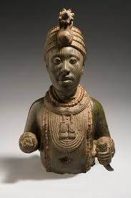
Nigerians subscribed to the diffusionist theory for one or more reasons such as patriotism, consideration of prestige, or religious bias. Scholars argued about the origin of the Nigerian people especially the Yoruba people. But by the 1970s the diffusionist view was being questioned by the anti-diffusionist . The anti-diffusionist was led by linguists, archeologists and anthropologist and they had turned up with serious doubts on the validity of the diffusionist theory. Linguistic evidences show that the Yoruba people already were inhabitants of West Africa before the advent of Oduduwa, that is to say that there was already a monarchial form of government which had developed before the Oduduwa period, but as a head of a small but mighty organized group Oduduwa took over authority and its impossible to say when Oduduwa’s reign began.

Slide 4
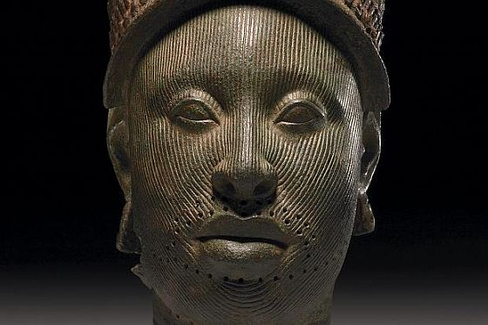
For the Igbo people, it was suggested that they began to emerge as distant people some 6,000 yrs ago, the scholars had the theory that the Nri-Awka-Orlu axis was the earliest centre of the Igbo settlement. The Igbo people were known to just exist as their own with no origin.
For the people of Edo their origin is a matter of great controversy. Some other people of Nigeria were the people of Cross River Valley and the Eastern Niger Delta, the people of the Benue Valley, the people of the Benue-Chad Corridor, Fulani and Shuwa Arab and the Hausa of Northern Nigeria.
The economies practiced by various Nigerian pre colonial societies were a measure of their adaptation to their environment. In the traditional society inter and intra ethnic commercial activities were encouraged.

Slide 5
People of cross river valley and the eastern Niger delta
The peoples of the cross river region and the eastern Niger delta, the Ibibio, the efik,the ijo have strong linguistic and historical ties with the middle Benue region of Nigeria. The largest linguistic group in the are, the Ibibio, also seem to have the longest established in the region.
The first movements into the area must have been before the Christian era.
People of Benue valley
The Benue valley is in a transitional are between the wet forest region to the south and the dry open savannah to the north. The geographical location of the valley has made possible the cultivation of both forest location and savannah crops.
The jukun were said to have established state machinery in the length and breadth of the Benue valley Their influence extended to the Niger Benue confluence area.

Slide 6
The Fulani and shuwa Arab
The Fulani have also laid an important role in the socio political and cultural developments of the Benue chad corridor.
The shuwa arabs are another great pastoral people of bornu. They too are comparatively later arrivals. Although some Arabs were said to have arrived Bornu as early as the later 14th century, it was not until the 16th century that constant Arab migration took place.
The Hausa of Northern Nigeria
To the west of the Kanuri is an extensive stretch of plains often referred to as kasa Hausa. From very early times these plains were the home of various peoples: the Hausa, bolewa, Ngizim, Magar, Buduma, Koleko, and others. But the Hausa constituted the mist dominant group.

Slide 7
Subsidiary to agriculture, trade was an important aspect of Igbo economic activities. There were 2 facets of trade which were the up-country trade and the long-distance trade. The economic life in pre colonial life among the Yoruba people rested on three legs-agriculture, trade and manufacture. Agriculture was the primary occupation producing yams, different kinds of beans, vegetables fruits and palm produce etc.
Lastly, in the days of poor or rather non-existence technological development, the Nigerian people were not living in isolation of one another; rather they learnt from one another's technology and there was a platform of unity

Slide 8
CHAPTER 2 CONCEPT OF CULTURE AND EARLY CULTURAL CULTURES IN NIGERIA
Culture is a complex phenomenon which can be viewed from various perspectives because of its considerable multi-dimensional nature. Culture is a sum total of peoples way of life or the way of a people which includes knowledge, belief, art, morals, customs and other capabilities acquired by man as a member of society at a given time in order to meet the challenges of living in their environment. Culture gives order to all aspects of life. Culture plays a key role in shaping the political, economic, social, philosophical etc. mode of the people as a group. Culture can also be viewed from a disciplinary aspect

Slide 9
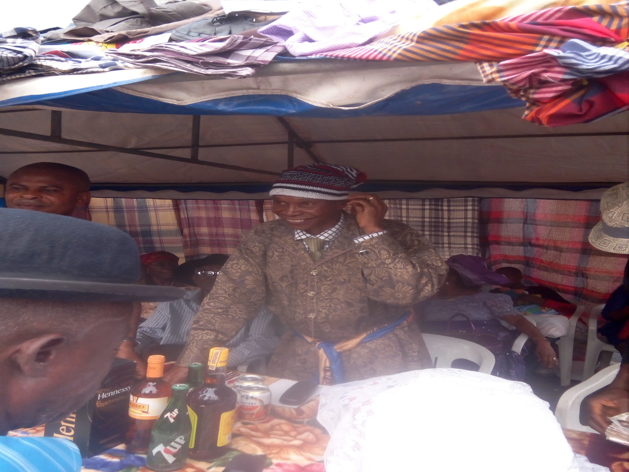
Its passed from generation to generation from people of different backgrounds. History of a society is the only means to possibly understand their culture. Culture can be considered mental and manual (i.e. mans creative abilities expressed in his capability to transform his environment).
Culture can be classified into 2; the material or tangible or movable aspect which includes products of technology and physical objects e.g. canoes, lorries. The second category is the non-material or intangible or immovable aspect e.g. villages, hamlets etc. They can also be considered the value system of a society.
Its passed from generation to generation from people of different backgrounds. History of a society is the only means to possibly understand their culture. Culture can be considered mental and manual (i.e. mans creative abilities expressed in his capability to transform his environment).
Culture can be classified into 2; the material or tangible or movable aspect which includes products of technology and physical objects e.g. canoes, lorries. The second category is the non-material or intangible or immovable aspect e.g. villages, hamlets etc. They can also be considered the value system of a society.

Slide 10
CHARACTERISTICS OF CULTURE
Dynamism
Transmittable (i.e. continuity and change)
Culture is learned not inheritable
Culture is commutative
Culture is relative to time and place
Culture can also be similar to each other such is the similarity in naming ceremonies, food, etc

Slide 11
ROLES OF CULTURE IN THE SOCIETY
It presents a crucial input for the development of service in any given society. It represents the basic structural capital needed for societal transformation and also pacifies conflicts among people. Of all culture promotes inter-group relations; and also provides a building block for ethnic identities. Cultural aspects are repellent to foreign influence. Its believed to have been modified to suit contemporary times because of cultural dynamism. Works of art can also be used to present the Nigerian peoples culture , they show that Nigeria has also like other people of the world passed through stages of developments.

Slide 12
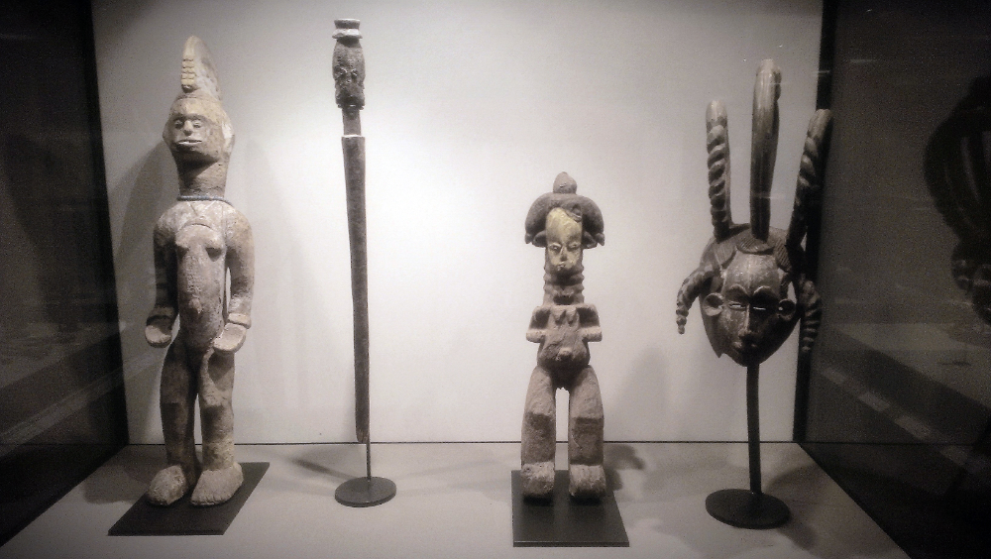
But the preservation of these various works of arts are also problematic. Unfortunately, due to colonialism some of them have been exported from Nigeria bringing about disorientation and distortion of our people; some were stolen and some others were destroyed.
The government should provide security to protect these works of art as it helps promote the culture of the Nigerian people.
But the preservation of these various works of arts are also problematic. Unfortunately, due to colonialism some of them have been exported from Nigeria bringing about disorientation and distortion of our people; some were stolen and some others were destroyed.
The government should provide security to protect these works of art as it helps promote the culture of the Nigerian people.

Slide 13
Some aspects of Nigeria Culture
Different people of Nigeria have both the material and non material aspects of culture. The material aspects are observed in the various technologies of Nigerian indigenous society. These include various forms of tools, household utensils etc. that were used in the pre colonial period. Some of these are still being used in contemporary Nigeria.
These include farming implements such as hoes, cutlasses, baskets and household utensils like cooking pots, gourds , plates ,spoons other include; dwellings such as houses and huts their structures and materials used. Others are food and medication which included the mode of preparation and the use of herbs respectively.

Slide 14
Early cultural centres in Nigeria
The discovery of early cultural sites in Nigeria has generated a lot of controversy among western scholars. This was because such discoveries were least expected of the Africans because of the sophistication of the works of art. Such discoveries in Nigeria and other parts of Africa had been ascribed to the handwork of white originators. These discoveries were the ile ife, Nok and Igbo Ukwu cultures.
The Ile Ife Art
Among the Yoruba of western Nigeria and also among the Yoruba in diaspora, Ile ife is believed to be the cradle of man kind all human beings. Many excavations had been carried out in Ile Ife which revealed the art of ife as one of the most marvelous in the world.

Slide 15
Nok Culture
The culture is named after a small village in the North central Nigeria where the first work of art of this type was discovered in 1943.
Since 1943 over one hundred and fifty works have been discovered.
The Nok dated conservatively between 500bc and AD 200, produced the earliest known terracotta sculptures and iron implements in Africa, South of the Sahara. The principal medium of the art of Nok is terracotta and the artists had a great mastery of this material. They successfully fired their clay sculptures, some of which approached life, to the extent that some of them have survived in good condition for over 2000 years. This shows that the makers were not only artists but technologists as well.

Slide 16
Igbo Ukwu
Igbo ukwu is a small village about 40kilometres south east of Onitsha, precisely near awka.The discovery at Igbo ukwu which was made casually by a man digging a well provides us with the first evidence of the artistic use of copper alloys in the whole of black Africa.
Significance of the Nigerian Arts
Most of the work of arts already discussed are housed in museums all over Nigeria cities such as Lagos,Ile Ife, Owo ,Benin,Enugu,Sokoto,Katsina,Kano,Kaduna,Jos,Esie,Oron etc. These various objects in our museums have shown clearly that Nigerians like people in other parts of the world passed through various stages of development. It shows that Nigerians were able to produce tools and weapons which enabled them control and adapt themselves to their environment. The various objects of arts, especially in bronze and brass show that Nigerians were skillful artists.

Slide 17
Problems of preserving Nigerian Arts
Unfortunately colonialism brought a serious cultural disorientation or distortion to our people. The artistic and cultural achievements of the past of our people were illegally exported from Nigeria, even some of the Art works were physically destroyed while others were stolen. The colonial missionaries made it their business to make bonfires of arts of our land and to ridicule the ideas and belief about them, such works of art which had been destroyed by the missionaries had no replacement.
There is also inadequate security for the works of art exhibited in the museums for the fact that there is frequent theft in our museums.

Slide 18
CHAPTER 3 SOCIO-POLITICAL INSTITUTIONS IN TRADITIONAL NIGERIAN SOCIETIES
The political community can be considered as a family as it can be dramatized in the legend and myths portraying its segments as descendants of a common ancestors or founding father. Politics and government ere considered processes of regulating normal life among relations. Social and political institutions were to promote the unbroken ties of friendship. African traditional societies had a deeply-rooted belief in the living, the death and the yet unborn i.e. the living worked, the believed in the dead in times of trouble to intercede on their behalf and also the yet unborn to be born and work with them.

Slide 19
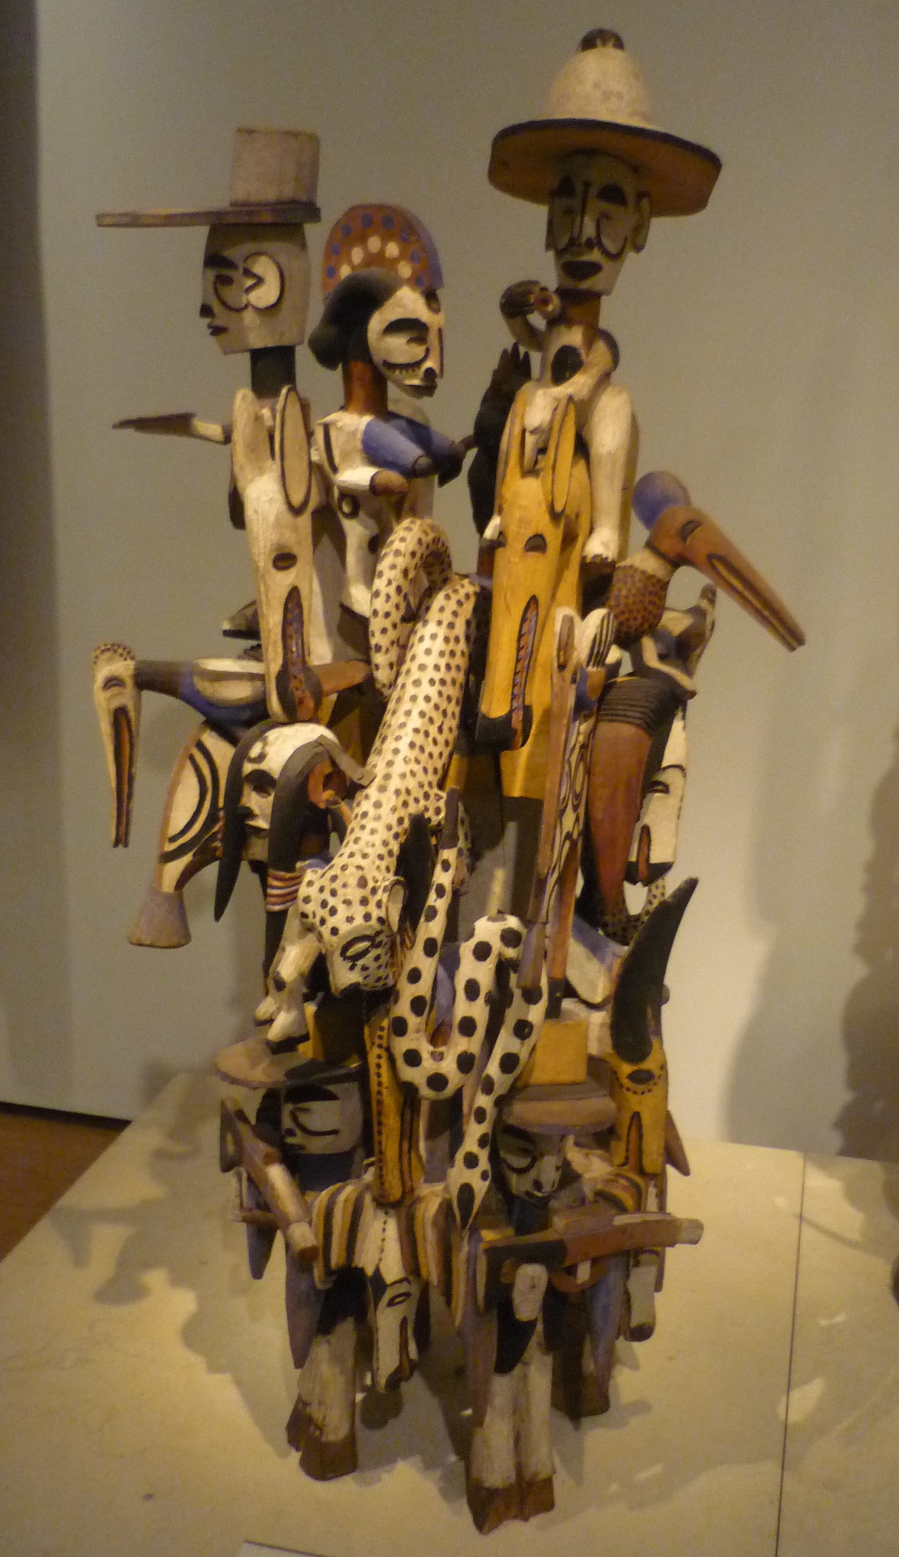
God also created divinities and ancestors to police the traditional society, which makes the world an organization of traditional society maintained by the spiritual forces that pervade it.
In the traditional society there were 2 forms of government which were the village, republic and the monarchial system of government. In the monarchial system the king was the supreme and no one could question his authority. Religion and taboos were constraint to the powers of the king, while in the village republic the oldest man in the linage was the focus of justice and authority. Other institutions in traditional societies were the Fulani Jihadists of 1804 and other non-Fulani groups.
God also created divinities and ancestors to police the traditional society, which makes the world an organization of traditional society maintained by the spiritual forces that pervade it.
In the traditional society there were 2 forms of government which were the village, republic and the monarchial system of government. In the monarchial system the king was the supreme and no one could question his authority. Religion and taboos were constraint to the powers of the king, while in the village republic the oldest man in the linage was the focus of justice and authority. Other institutions in traditional societies were the Fulani Jihadists of 1804 and other non-Fulani groups.

Slide 20
The system of the Village republic
The Ibibio of the south eastern corner of Nigeria and the central and north eastern Igbo practiced the system of the village republic. Among the Igbo direct democracy was practiced up to lineage level. At that level the oldest man in the unit was the focus of justice and authority.
He took charge of the ofo. The symbol of justice and authority, and offered sacrifices to the ancestors for the welfare of his men.
I there was any dispute it was settled by the an assembly of all men and women when the issue concerned the latter. Everyone was qualified to contribute to discussions on any matter, at the of which some elders were selected to withdraw for further deliberations. Their decisions was then announced to the assembly for approval. If the decision was acceptable it was approved, otherwise it was reconsidered and represented until there was a consensus.

Slide 21
The jihadists of 1804 and the non Fulani Groups
The incursion of the Fulani jihadists into Northern Nigeria which began in 1804 has its impacts on the structure of the government among the non Fulani ethnic groups in the North. The jihad effected a political revolution which embraced a little more than half of the present day Nigeria.
Observations of Islamic practice in religion, law and war was part of the new emirate system imposed on the north traditional societies. The Fulani conquerors, the emirs ,established at their courts a new judicial system under a qualified Muslim legal scholar, the Alkali, who heard appeals from the court of salenke, a judicial officer under the now sub ordinated Habe(Hausa) ruler.

Slide 22
Executive Machinery
The point was made earlier that traditional societies were not noted for large bureaucracies. Yet decisions were efficiently executed. Villages were face to face communities and decisions of elders or their assemblies were not difficult to enforce. In chiefly societies, the aura of divinities around the king was adequate to ensure compliance with orders emanating from his court. In most traditional societies, secret societies were valuable as instruments of social control and agencies for enforcing decisions

Slide 23
CHAPTER 4 INTER GROUP RELATIONS IN NIGERIA
Intergroup relations can be defined as the interactions between 2 or more distinct cultural and linguistic ethnic group through marriage, migration, diplomacy or quest for economic power. It could also be through violence.

Slide 24
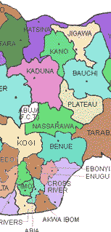
FACTORS OF INTERGROUP RELATIONS
GEOGRAPHY:
It encouraged the existence of network of land routes which promoted economic activities and intergroup relations
MIGRATION:
Migration is a common phenomenon in history as it has influenced the pattern of relations among various groups in Nigeria. It could be necessitated by the search for better economic opportunities. Migrants interest with their host communities and in some cases, settle permanently and imbibe the culture and other aspects of life of their host.

Slide 25
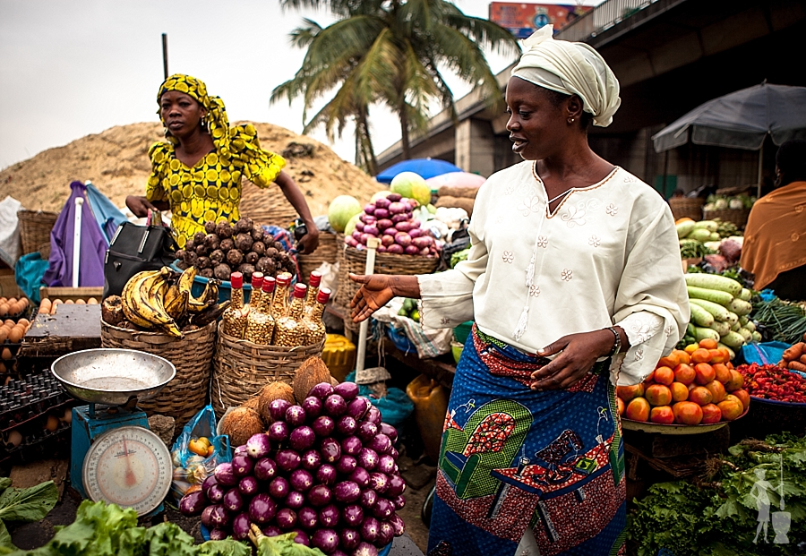
TRADE:
Economic interaction is necessary since no community is self-sufficient. They had to interest with neighboring communities to get what they wanted and a times they had to give their own good in form of trade by barter.
Other factors of intergroup relations could be marriage, cultural, affinity, diplomacy, religion, war, slave trade.
One of the consequence of intergroup relations was the diffusion of socio cultural values. For example finding traits of one community in another community. Intergroup relations also led to the development of high ways. As new routes were created the old ones were made effective which also resulted to the growth of markets.

Slide 26
Marriage
Inter ethnic marriage was another issue which led to interactions between people of various groups. For instance there were intermarriages between the itshekiri and urhobo in the water front camps established in some urhobo communities for the purpose of collecting palm oil and this reduced tension between the two groups.
Cultural Affinity
This served as a rallying point to some communities during the pre-colonial period in Nigeria. For example the oduduwa legend of the origin of Yoruba land posited that oranmiyan a prince of oduduwa was sent to rule Benin after the demise of oggiso dynasty in Benin. While in Benin oranmiyan had a son called eweka through a Benin lady.oranmiyan later returned to Yoruba land while eweka his son grew grew up and became a king in Benin. Today ewka is referred to as the ancestor of the present line of Edo monarchs.

Slide 27
Diplomacy
The act of diplomacy was not alien to the communities or groups existing during the pre colonial period in Nigeria, rather it was a means of facilitating or cementing relations between them. Diplomacy then was a process through which empires kingdoms or communities communicated with one another through official agents. This communication may be for the purpose of exchange of gifts sending of congratulatory messages expression of courtesy, recognition of recipient superior position, expression of support or to normalize relations between communities. For instance the awujale of ijebu ode sent a congratulatory message to oba akintoye of Lagos in 1851 when the latte was restored as Lagos monarch.

Slide 28
Religion
It is known that mutual understanding and feeling of brotherhood usually exist among the people who share the same religion , irrespective of their ethnic groups. Therefore religion was another factor that encouraged mixing of people from various areas. Some Hausa mallams visited Yoruba land in order to spread Islam religion there, while some Christians from south moved up north to preach and convert people into Christian religion. The adherents of a particular religion also exchanged visits during meetings, conventions, crusades and other ceremonies and they were always encouraged to accommodate one another and see themselves as children of the same God. This went a long way in promoting intergroup relations.

Slide 29
War
Wars were fought between communities to annex territories , acquire land or demonstrate supremacy. For example the contacts between Benin and Igbo communities around the west of the Niger were mostly characterized by wars of conquest. The result of this was cultural diffusion in Igbo communities such as agbor, unnunede, oma,okpu,aboh and udunnuose.Moreover the Aro of Igbo group engaged in war with the Ibibio and expelled them from Arochukwu oracle Igbo, transformed the oracle from a local deity to one whose influence extended far and wide in Igbo land.
Slave trade
According to L.D. Dioka many states in the delta had their population replenished from the supply of Igbo slaves. Igbo slaves were found in delta communities such as bonny,Elem,Kalabari and calabar. Thus intergroup relations resulted in the great influence which Igbo language had among the communities especially bonny.

Slide 30
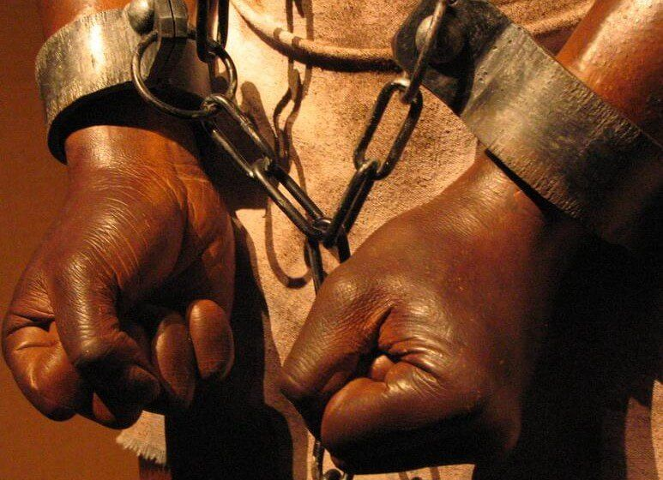

CHAPTER 5 THE ATLANTIC SLAVE TRADE
Slavery has said to had represented the appropriation of a human person as another persons property. It abhors the night to freedom, liberty and other property. It could e through inheritance; slaves were of great impact in Nigeria as their exports also had a deleterious impact on Nigeria. On the other hand slave trade was destructive and underdeveloped Africans because of the massive loss of labor force through transfer of population.
This new trade began about the late 15th century and its rapid expansion began in the middle 17th century. Transportation of slaves was also gruesome as high causalities were recorded. The slave, therefore was of 2 faces, good and bad for the dealers and the commodities respectively
Slavery has said to had represented the appropriation of a human person as another persons property. It abhors the night to freedom, liberty and other property. It could e through inheritance; slaves were of great impact in Nigeria as their exports also had a deleterious impact on Nigeria. On the other hand slave trade was destructive and underdeveloped Africans because of the massive loss of labor force through transfer of population.
This new trade began about the late 15th century and its rapid expansion began in the middle 17th century. Transportation of slaves was also gruesome as high causalities were recorded. The slave, therefore was of 2 faces, good and bad for the dealers and the commodities respectively

Slide 31
The scope of Atlantic slave trade in Nigeria
The first cargoes of slaves left Nigerian shores in European ships for the Gold coast where Portuguese traders bought them. The Portuguese contact with Benin by 1485 led to a concentration of slave trade in Benin Rivers. By the end of the 15th century, the Portuguese traders had established contact with the kingdom of ijebu; in the central and eastern delta, the slave trade developed with newly established Portuguese colonies on the island of sao thome and principe. Some African historians have argued that it was the ijaw who first started the trade in slaves near the mouth of slave rivers. But the ijaws got their slaves from the hinterland people who brought slaves cows and sheep in exchange for ijaw salt and fish.

Slide 32
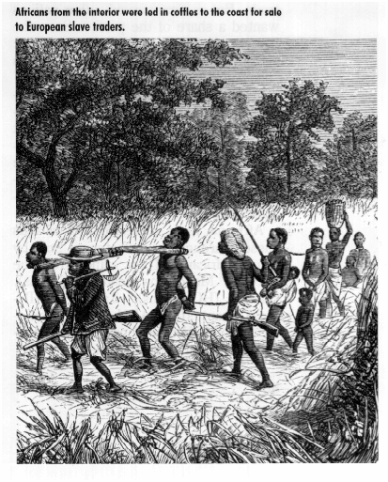

Atlantic slave trade can also be called triangular slave trade because it went from Europe to Africa, to America and back to Europe. The Europeans shipped Africans as slaves to the New World (America).
Slave trade was abolished in 1807 by an act of British parliament. Three factors of made it possible for the British act of parliament to reconsider the implications of slave trade there by preparing a ground for victory for anti-slave trade movement between 1772 to 1802, when the British parliament passed the law of abolition. These factors were the humanitarian reason that slave trade was an illustration of mans inhumanity to man, contradicting to the biblical injunction of loving ones neighbor as ones self. Another was that with the emergence of industries, Britain realized she should maintain her supremacy in world trade in terms of manufacturing and need for large market.
Atlantic slave trade can also be called triangular slave trade because it went from Europe to Africa, to America and back to Europe. The Europeans shipped Africans as slaves to the New World (America).
Slave trade was abolished in 1807 by an act of British parliament. Three factors of made it possible for the British act of parliament to reconsider the implications of slave trade there by preparing a ground for victory for anti-slave trade movement between 1772 to 1802, when the British parliament passed the law of abolition.
These factors were the humanitarian reason that slave trade was an illustration of mans inhumanity to man, contradicting to the biblical injunction of loving ones neighbor as ones self. Another was that with the emergence of industries, Britain realized she should maintain her supremacy in world trade in terms of manufacturing and need for large market.

Slide 33
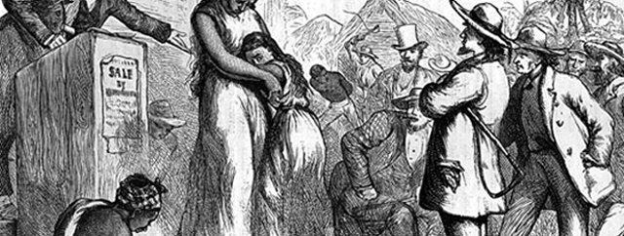
.
Lastly was the social factors based on the growth of new ideas in Europe at the end of the 18th century. The United States broke away from England and no longer supported her economy with slavery, Abraham Lincoln gave the final death blow to slavery as it was abolished finally.
The slave trade also have negative and positive effects on the Nigerian economy.

Slide 34
ADVANTAGES
Provided opportunities for long distances and international trade and led to other kinds of relationship with Europeans and Americans.
It stimulated external trade as they expanded their bounds of their trade activities and territories.
It brought about development of rich and powerful new class of business men who were able to carryout long business negotiation.
It led to new settlements, criminals and taboo breakers instead of being killed were sold and exported to North America to start a new life.

Slide 35
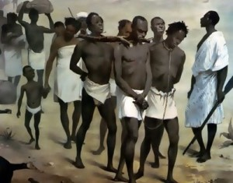
DISADVANTAGES
It brought about depopulation as there was no agreement on the number of slaves take away from Nigeria. Most of the people taken away were of the working population and were without physical defects.
It engendered wars among neighboring States
It brought about trade imbalance
It left no impact on the technological or mechanical skills of Nigeria
It created great psychological effect on the people of Nigeria and their culture as they became inferior to Europeans.

Slide 36
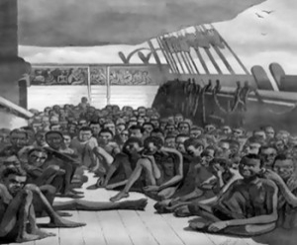
N/B:
Slave trade had a demographic impact of Nigerians reproductive capacity. It brought about economic backwardness and mixed culture.
N/B:
Slave trade had a demographic impact of Nigerians reproductive capacity. It brought about economic backwardness and mixed culture.

Slide 37
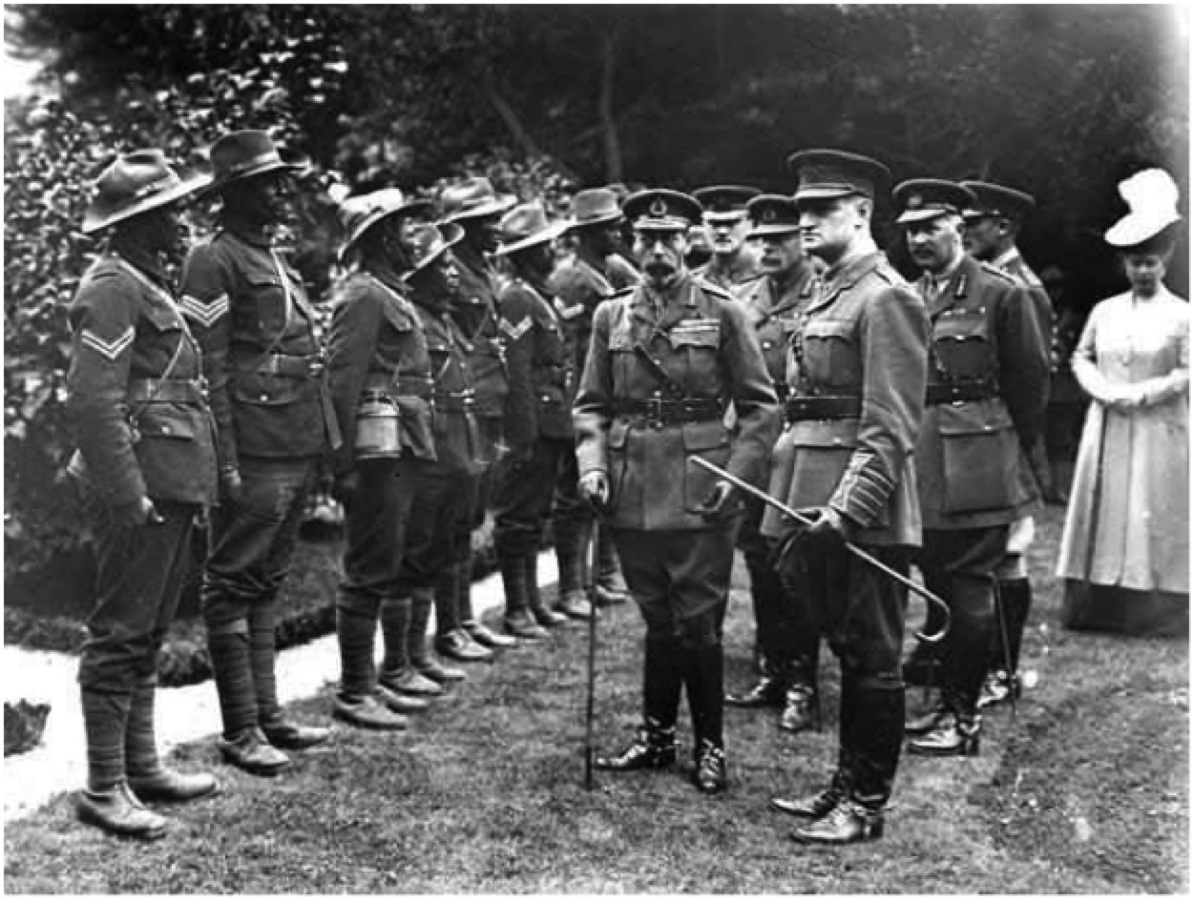
CHAPTER 6 COLONIALISM AND ITS IMPACT
CHAPTER 6 COLONIALISM AND ITS IMPACT
Prior to colonialism of Nigeria by Britain, the Nigeria nation was a more geographical expression, containing a number of district empire.
Colonialism can be defined as a forceful acquisition or absorption of a nations sovereignty and independence by a foreign power. It is however evident that the central motive behind colonialisation of Africa was economic considerations, informed by Europeans powers. Furthermore, the industries engaged in large scale production of goods even in excess of the home consumption capacity, hence, overseas market was needed for the sale of excess goods.
Prior to colonialism of Nigeria by Britain, the Nigeria nation was a more geographical expression, containing a number of district empire.
Colonialism can be defined as a forceful acquisition or absorption of a nations sovereignty and independence by a foreign power. It is however evident that the central motive behind colonialisation of Africa was economic considerations, informed by Europeans powers. Furthermore, the industries engaged in large scale production of goods even in excess of the home consumption capacity, hence, overseas market was needed for the sale of excess goods.

Slide 38
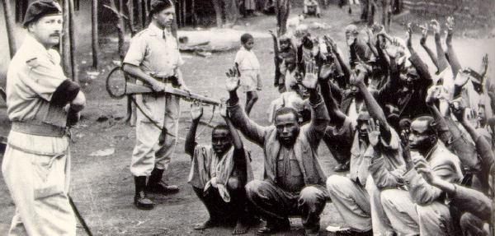
There are 2 methods of conquest and they are the military method and diplomatic method. On the other hand, the use of diplomatic method is that which was also referred to as persuasive means. British officials deceives some Nigerian traditional rulers and chiefs into signing treaties of friendship. While the military method meant the deployment of the British police and military forces to suppress opposition anywhere they met one. The British spuriously interpreted the use of forces as “pacification policy”. They claimed that opposition movements which resisted their penetration and occupation.
The above point highlights the facts that the whole Nigeria did not just fall like a peak of cards to British domination. On the contrary, leaders of some communities in Nigeria displayed bravery by confronting the British in order to prevent them from the conquest or domination of their territories.
There are 2 methods of conquest and they are the military method and diplomatic method. On the other hand, the use of diplomatic method is that which was also referred to as persuasive means. British officials deceives some Nigerian traditional rulers and chiefs into signing treaties of friendship. While the military method meant the deployment of the British police and military forces to suppress opposition anywhere they met one. The British spuriously interpreted the use of forces as “pacification policy”. They claimed that opposition movements which resisted their penetration and occupation.
The above point highlights the facts that the whole Nigeria did not just fall like a peak of cards to British domination. On the contrary, leaders of some communities in Nigeria displayed bravery by confronting the British in order to prevent them from the conquest or domination of their territories.

Slide 39
Resistant Movement
There were some community rulers like king jaja of opobo, king kosoko of Lagos, awujale of ijebuland, Atahiru II of sokoto caliphate, Nana of itshekiri..etc. who stood up to the challenge of preventing the British conquest of their territories. Some of them refused to sign treaties of any sort with the British. In his own case king kosoko of Lagos did not find any ground of compromise with the British. He told them frankly that he did not need their friendship and this cost him his throne. He was dethroned while Akintoye who accepted to be British stooge became his successor. King jaja of opobo too refused to sign commercial agreement with the British. He decided to be in control of the exportation of palm oil in his territory. This earned him abduction by the British and he was exiled to the west indies. Nana of itshekiri though not a king used his influence to stop the Royal Niger Company from gaining control of the trade in itshekiri land. This also led to his exile to the Gold coast.

Slide 40
Reasons for the failure of Resistant movements
Some of the communities resisting British penetration and occupation were facing serious internal political conflicts at the same time. The conflicts prevented stability and unity.
Lack of unity made some community leaders to betray their kinsmen. Such leaders preferred being under the British control rather than remain under the suzerainty of their fellow Nigerian rulers.
British colonial Administration
The country was divided into colonies and protectorates for administrative purposes. These were; the colony of Lagos with Sir Egerton as its High commissioner; the protectorate of southern Nigeria with Sir R.D. Moore as its High commissioner, and the protectorate of Northern Nigeria with Sir Frederick Lord Lugard as its High commissioner.

Slide 41
The structure of British Colonial Administration
The Administration of Nigeria was divided into central and local or native administrative units. The central administration involved the Governor , who was in charge of Nigerian colony and the legislative and executive councils. Vital issues affecting Nigeria were formulated or discussed in both legislative and executive councils established by the colonial administration.

Slide 42
Moreover, in January 1914, the colony and protectorates of Southern Nigeria was amalgamated with the Northern protectorate, Just like the former amalgamation.
Indirect rule system can be defined as a system in which an alien power rules or controls a group of people through intermediaries. Furthermore, the only industrial sector which the British encouraged and developed was “extractive”, this had to do with the mining of the minerals which was needed for their manufacturing.

Slide 43
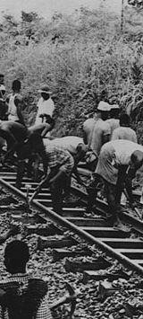
POSITIVE IMPACT OF COLONIALISM
It brought about the formation of political parties.
It encouraged the spirit of nationalism in Nigeria and gave room for constitutional development.
It created wage earning class.
It facilitated intergroup relations, through the roads and railways constructed.
Helped in growing the people for their future roles as administrators and politicians.

Slide 44
NEGATIVE IMPACT OF COLONIALISM
It led to economic exploitation of Nigeria.
It led to the flooding of Nigeria's market with foreign goods with the resultant collapse of the indigenous industries and technologies.
It created the phobia of white superiority over the black race.
It led to suppression of opposition which is the bane of Nigerian politics today.
Creation of unhealthy rivalries between Nigerian educated elites and traditional rulers.

Slide 45
CHAPTER 7 NATIONALISM AND INDEPENDENCE MOVEMENT IN NIGERIA
The Nigerian local and traditional rulers were protagonist of anti-colonial resistance, especially during the period of the scramble. These rulers resisted European penetration into their local territories.
Origin OF Modern Nigerian Nationalism
The Nigerian local and traditional rulers were protagonists of anti colonial resistance, especially during the period of scramble. These rulers resisted European penetration into their local territories. This was the period referred to as the era of proto-nationalism when these rulers and leaders attempted to protect their territories against British invasion.

Slide 46
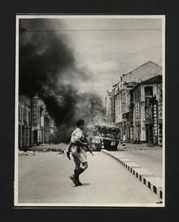
FACTORS THAT INFLUENCED NATIONALIST AGITATION
Elite as watchdog
Politico-Cultural Organization
The press
Blacks of the world
In very many ways, the missionaries wittingly or unwittingly contributed a great deal to the growth of Nigerian nationalism. Secondly, the missionaries, by their sponsorship of the study of African languages and the encouragement of these languages in their religious and educational activities. Thirdly, the missionaries attitude towards African culture and tradition was an important factor in the growth of cultural nationalism.

Slide 47
.
To worsen the situation, some of the missionaries were believers in the inferiority of the Africans and consequently they were not less arrogant and paternalistic in their attitude. This type of attitude was all the more irritating as it was contradictory to the belief and teaching of Christianity which it was supposed to profess.

Slide 48
Elite as Watchdog
Because of the longer tradition of western education in the colonies there was by 1900 a seizable number of educated people called the elite who through their newspapers and associations acted as watchdogs of colonial rule, protesting against its abuses. Members of the elite were all known to each other across the west African coast from Bathurst to Lagos.
Politico cultural organizations
The elite also political organization in attempt to keep a watch on the colonial powers. The Aborigines Right Protection Society established in the Gold coast in 1897 was the first important political organization of the elite in west Africa. Similar organizations were established in each of the colonies like the People Union in Lagos.

Slide 49
The press
The press was an important element in keeping the elite united. By 1937 fifty newspapers at one time or the other were registered in West Africa. Some of the famous were he Lagos weekly record which began in 1890, the Sierra Leone weekly news which began in1884 and the Gold coast Independent which was founded in 1895.
Blacks of the world
During the inter war years, the various sections of the world inhabited by the black people became more conscious of each other than ever before. Events among the Negroes in America and the west Indies were influencing Negroes in Africa and African events were being closely watched by a growing number of New world Negroes. The elite of the new world and Africa began to feel that the elevation of the race must be an international effort, that a victory over segregation in America was as important as a victory over colonialism in Africa.

Slide 50
Pan Africanism and African Nationalism
The beginning of the Pan African collaboration against colonialism dates back to 1900 when a Trinidadian Barrister, Henry Sylvester Williams, organized a conference in London to protest the treatment of Africans in Rhodesia and South Africa. The plight of the people in both territories attracted the feelings of Africans in the Diaspora.
Dr. W.E.B. Du Bois, one of the foremost architects of Pan Africanism, went to France to organize a Pan African congress that was to be held concurrently with the peace conference to press for the rights of Africans.
The Missionary Factor
They were agents of western culture including western education. Their educational activities were of tremendous importance in that, by providing Nigerian youths with education, they supplied them with the key to progress and also with an effective weapon to fight colonial rule.

Slide 51
West African Students Union
Nigerian nationalism also received a boost from African Students including Nigerians outside the continent. These youths grouped themselves into associations aimed at emancipating Africans from European domination.
Italio Ethiopian Invasion
Another important spur to outburst of nationalist activity was the Italian Invasion of Ethiopia which survived the partition of Africa and symbolized African Independence for all Nationalists.
The Nigerian National Democratic Party
The NNDP was formed by Herbert Macaulay in 1920 to mobilize public opinion against the British governor in Lagos. The formation of the political party was specifically to fight the Eleko issue effectively.

Slide 52
The Nigerian Youth Movement
NYM was started in 1934 by J.C Vaughan, Ernest Ikoli and Oba Samuel Adesanya to express opposition against the establishment of Yaba college. At its inception, it was a pressure group, and it was known at that time as Lagos Youth Movement. Though it failed to achieve its aim, it nevertheless continued in existence and in 1936 it became a real political organization which was renamed Nigerian Youth Movement with branches all over the country.
The National Council of Nigeria and Cameroon
The NCNC was formed by the Nigerian Union of Students in 1944 in reaction against the harsh decision of the colonial administration to punish some group of students of the kings college, Lagos whose hostel was commandeered by the army.

Slide 53
The Action Group
While all these were happening, Chief Obafemi Awolowo with some prominent Yoruba in London had formed in 1945 a Yoruba cultural society called Egbe Omo Oduduwa.when the new Governor Sir John Macpherson set up the machinery for a comprehensive constitutional review which started in March 1949, the time was judged right to transform the cultural Egbe into a full political party called the Action Group.
The Northern Peoples Congress
In 1948, Dr Dikko, the first Northerner to qualify as a doctor , had gathered together a group of educated friends and colleagues in Zaria to form a cultural organization with no political motives at all. Both Abubakar Tafawa Balewa and Ahmadu Bello were members of the association. But when the first regional elections loomed in sight, a political party was found necessary for the purpose of campaigning for the elections. So Balewa and Ahmadu requested the leadership of the cultural society to allow it to be transformed into a political organization. Dr Dikko and some others complied and resigned from the society since they were civil servants. The new party was called the Northern Peoples Congress.

Slide 54
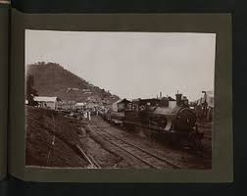
CHAPTER 8 PROBLEMS OF NATIONAL-BUILDING IN NIGERIA
CHAPTER 8 PROBLEMS OF NATIONAL-BUILDING IN NIGERIA
This diversity has featured in most of her socio-political relationships such as party system, census, employment, resource allocation, education etc. It is these diverse elements that the various political office holders since independence have intended to weld together a constitute a nation. In Nigeria the problems of cultural diversity are associated with ethnic, social, cultural, linguistic and religious differences. Nigeria is composed of well over 250 ethnic groups. These includes HAUSA, Fulani, of Northern Nigeria, Igbira, Bagyi, Igala, Tiv, Idoma, Bajju etc.
This diversity has featured in most of her socio-political relationships such as party system, census, employment, resource allocation, education etc. It is these diverse elements that the various political office holders since independence have intended to weld together a constitute a nation. In Nigeria the problems of cultural diversity are associated with ethnic, social, cultural, linguistic and religious differences. Nigeria is composed of well over 250 ethnic groups. These includes HAUSA, Fulani, of Northern Nigeria, Igbira, Bagyi, Igala, Tiv, Idoma, Bajju etc.

Slide 55
At times the story of the origin of the various people of Nigeria takes of hostile relationships which could breed disunity among them, most Nigerian groups emphasizes separately rather than a common identity through then tradition of origin. At the beginning of colonial rule in Nigeria, the British introduced an indirect rule system of administration which was used as a base for uniform administrative structure in the country.
The Richard Constitution that divided Nigeria into three regions did not better than the 1914 amalgamation. Apart from the above, the early political leaders who later took over the mantle of power from the colonial administrators were not better than the colonial officers from they wee to take over. The AG crisis became deepened and intractable that it led to the passing of a motion of no-confidence by the majority of the party in power.

Slide 56
CHAPTER 9 THE MILITARY AND ITS IMPACT ON GOVERNANCE IN NIGERIA
CHAPTER 9 THE MILITARY AND ITS IMPACT ON GOVERNANCE IN NIGERIA
The fundamental reason for the ease with which the military seized power in the Nigerian state is the low political culture in the country. A country has a low political culture when among other things, its political structures have not been institutionalized or only weakly institutionalized, and dominant political norms “the rules of the game” have not been sufficiently internalized.
However, one fundamental reason for military intervention in Nigeria in 1966 was the weak state of internal cohesion.
The fundamental reason for the ease with which the military seized power in the Nigerian state is the low political culture in the country. A country has a low political culture when among other things, its political structures have not been institutionalized or only weakly institutionalized, and dominant political norms “the rules of the game” have not been sufficiently internalized.
However, one fundamental reason for military intervention in Nigeria in 1966 was the weak state of internal cohesion.

Slide 57
After independence in 1960, all the groups and political parties that had hitherto joined forces in the nationalist struggle for independence. The first Military Coup in Nigeria took place on 15th January 1966. The Coup was masterminded by the young Nigerian Army officers led by Major Kaduna Nzeogwu.
General Muhammad Buhari took over forcefully from the elected politicians on 31st December, 1983 on the allegation that they had grossly mismanaged the country's economy.

Slide 58
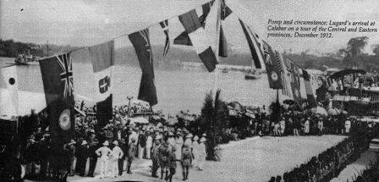
.

Slide 59
CHAPTER 10 INFLUENCE OF FOREIGN RELIGION ON NIGERIAN CULTURE
Christian began in places like Palestine, during the few days of death of Jesus Christ. Upon His death, the disciples of Jesus took seriously His injunction as written in the book of Mathew 28:18-20. Even though there have been traces of the Christian church on the northern coast of the African continent from the time of the Apostles, it was not until the 16th century that Christianity was first introduced to sub-Saharan Africa through the work of Portuguese missionaries.

Slide 60
POSITIVE IMPACT OF CHRISTIANITY
It contributed largely to the introduction of Western education Nigeria.
It also introduced modern medicine.
It also played major role.
It also preserved the local vernaculars.
It largely brought an end act of injustice.
They also contributed in the area of peace.

Slide 61
NEGATIVE IMPACT OF CHRISTIANITY
It aided the rise of colonialism on the African continent.
It also introduces personal relation of the believer to God, introduced by Christianity.
Also brought about the issue of religious intolerance to African traditional.
It also contributed to the destruction of the belief in and the fear of the wrath of the God.

Slide 62
Islam as a religion became prominent during the time of the Prophet Muhammad, sallallahu alaihi wasallam, in 662 A.D. in the Yarithrib, Saudi Arabia where he successfully developed the umma, the community of believers, to replace the existing clan loyalty that enveloped the area.
The first attempt to introduce the religion of Islam into Nigeria was made in Hausa land in the twelve century A.D. by some Muslim scholars from Bornu.

Slide 63
POSITIVE IMPACT OF ISLAM
Helped in uniting Hausa States under the Sharia law.
Also helped in the formation of trade links between Nigeria and North Africa.
Also influenced the documentation of Nigerian history.
It played a major role in the strengthening of the economic, diplomatic and cultural ties between Nigeria and Western Sudan, Central Sahara, North Africa, the Middle East and to some extent, Europe

Slide 64
NEGATIVE IMPACT OF ISLAM
The link with North Africa brought about by Islam led to the expansion of the slave trade.

